Slide 1
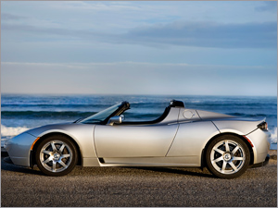
Battery Electric Vehicles
Battery Electric Vehicles run on electricity from batteries. They create no pollution and are very quiet. These cars also have very nice designs. But they are expensive.
Momilani Blas, Brian Ligh, & Justin Cordero
12/7/09

Slide 2
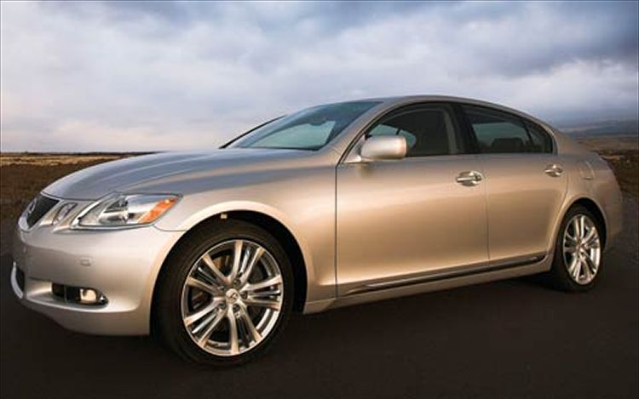
Need for Alternative Fuel Vehicles
AFVs are important to the world because:
1. Most AFVs produce less than petroleum vehicles.
2. Tax credits and financial incentives help lower the cost of AFVs.
3. Prices of alternative fuels are more stable and often lower than petroleum fuels.
4. Use of alternative fuels reduces our dependence on imported oil.
5. Automakers and engine manufacturers are expanding their lines of AFVs and engine types, and the network of fueling stations is growing.

Slide 3
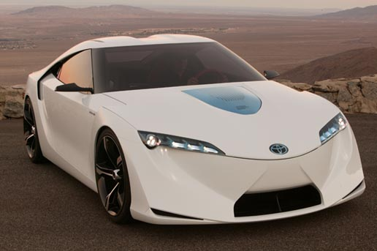
Types of Alternative Fuel Vehicles
Diesel
1. More power than gasoline
2. Reduced fire risk
Hybrid
1. Less air pollution
2. Can run on electricity
C. Electric
1. No pollution
2. Fuel efficient
Natural Gas
1. Cleanest burning fuel
2. Air pollution is produced
Flex fuel or ethanol mix
1. Renewable resource
2. Boosts efficiency of gasoline
Liquid Petroleum Gas
1. Less air pollution
2. More fuel efficient than gasoline

Slide 4
Hybrid Vehicles
Positives of HEVs:
1. Pollution: Emit less pollutants than do conventional gasoline powered cars
2. Fuel efficiency: miles per gallon anywhere from 45 to 60 miles per gallon
3. Government tax breaks
Negatives of HEVs:
More expensive
Hybrids heavier than regular gas powered conventional cars
Risk of electrocution in an accident
Metal hydride batteries are used in hybrids.

Slide 5
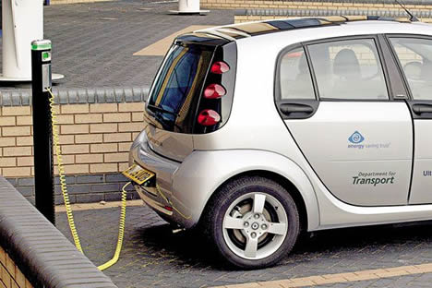
Plug-in Hybrid Vehicles
A Prius costs $10,000 more when upgraded than a regular one.
You can drive up to 40 miles in pure electric mode in the Hymotion PHEV.
Toyota, Ford, Chevy, Daimler and Fiskar are companies that are building/designing PHEVs for public.
Lithium-ion (Li-Ion) are batteries that are most used in PHEVs.
Plug-in hybrid vehicles are better than standard hybrid electric vehicles because they can be charged from wall sockets and solar panels creating far less pollution than hybrids.

Slide 6
Diesel / Biodiesel Vehicles
Positives of diesel:
More mile range than gasoline
Diesel engines last longer
More power for towing
Negatives of diesel:
More pollution than gasoline
More expensive than unleaded gasoline
Biodiesel saps food supply
Resources for diesel and biodiesel:
[Diesel]
Petroleum
[Biodiesel]
Animal fat
Waste vegetable oil
Algae

Slide 7
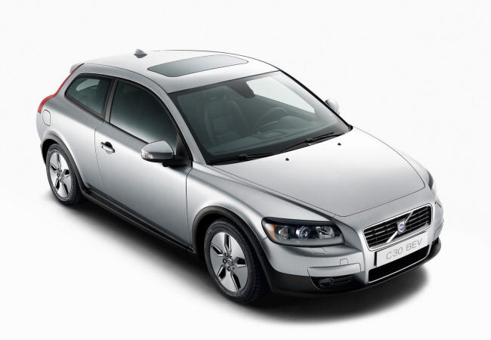
Battery Electric Vehicle
Positives of Battery Electric Vehicles:
Less pollution than gasoline
Batteries are recyclable
Simpler designed engine
Negatives of Battery Electric Vehicles:
Standard charge stations take 3-5 hours to fully charge
Very few locations of charging stations
More expensive than conventional cars
Methods to store electric power:
Fuel cells
Fly Wheels
Five ways to produce electricity:
Solar panels
Water turbines
Windmills
Thermal energy
Gas turbines

Slide 8
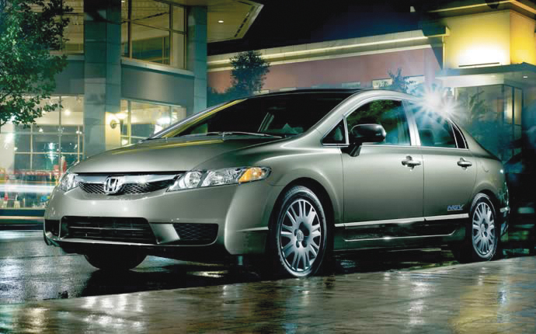
Compressed Natural Gas and Biomethane Vehicles
Positives of Natural Gas:
Low cost
Less pollution than gasoline
Domestic production
Negatives of Natural Gas:
Requires greater storage space
CNG Filling Stations are not as common as gas stations
Takes long time to fill tank at home
Sources CNG can be produced:
Animal farms
Sewage facilities

Slide 9
Liquid Natural Gas Vehicles
Positives of LNG:
LNG is an odorless, non-toxic and non-corrosive liquid
The conversion of natural gas to LNG, which can be shipped on specially built ocean-going ships, provides consumers with access to vast natural gas resources worldwide
LNG imports mean less pressure on natural gas prices in the US
LNG provides the opportunity to store natural gas for use during high-demand periods in areas where geologic conditions are not suitable for developing underground storage facilities
LNG produces less greenhouse gas and toxic emissions than low-sulpher diesel and biodiesel due to the molecular structure of gaseous fuels
Negatives of LNG:
Not a renewable resource
LNG tankers are huge
Sources LNG can be produced:
Natural Gas Reserves
Natural Gas

Slide 10
Ethanol Fuel Vehicles
Advantages of Ethanol:
Ethanol can be a renewable and sustainable energy resource.
E85 can be produced in the US and this will improve energy security.
FFV’s have the ability to run on either 100% gasoline up to 85% ethanol.
Resources of Ethanol:
Corn
Algae
Disadvantages of Ethanol:
The lower energy content of E85 results in slightly lower fuel economy and vehicle driving range.
Ethanol is corrosive
Hard to find refuel stations

Slide 11
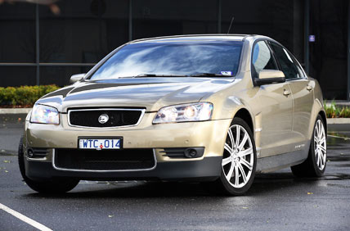
Liquid Petroleum Gas Vehicles
LPG advantages:
Not water soluble
Same fuel efficiency as gasoline
Less corrosion
LPG disadvantages:
Trouble start in cold weather
More expensive
Resources of LPG:
Liquid petroleum
Natural gas

Slide 12
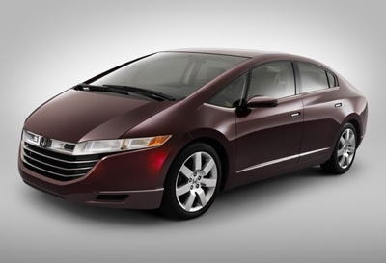
Hydrogen Fuel Cell Vehicles
Positives of Hydrogen Fuel Cells:
Renewable
3x more power than gasoline
Can be manufactured safely in large quantities
Negatives of Hydrogen Fuel Cells:
Less fuel stations
Cost, delivery, and storage must be overcome before hydrogen can be a full solution
Resources of Hydrogen Fuel Cells:
Water
Methanol

Slide 13
The Case for BEVs—Part 1
How much would gasoline cost (at $3.50 per gallon and 20 miles per gallon) in a standard gasoline car traveling 100 miles?
Approximately $17.50
How much would electricity cost in a BEV traveling 100 miles?
Approximately $8.00

Slide 14
The Case for BEVs—Part 2
Speed and aerodynamics affect mile range because if a vehicle goes slower than about 70 mph, the vehicle gets more fuel mileage. If a vehicle drafts another vehicle, the friction of the air does not affect the car as much, causing more mileage.
The only source that is cleanest is from a solar source or windmills.
80% of initial power goes directly to the wheels in a BEV.
20% of initial power goes directly to the wheels in a gasoline car.

Slide 15
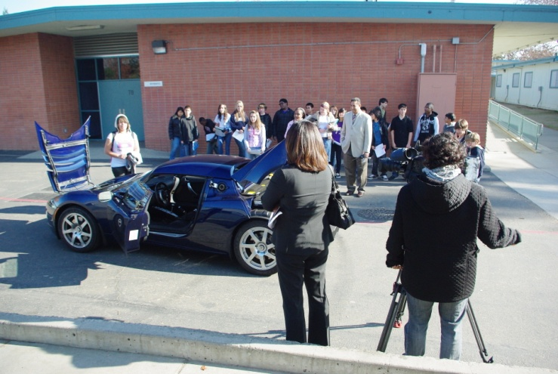
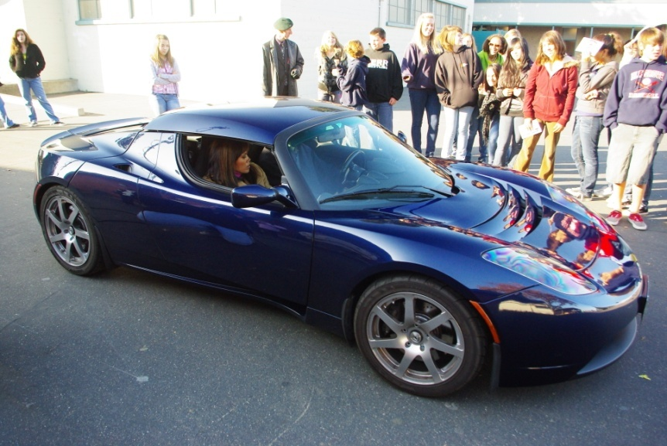
Alternative Fuel Vehicle Visit– Tesla Roadster
Demonstrator :
Jack Bowers
Occupation: Writer of an investment newsletter
BEV interests: 1. Cleaner fuel
2. Fan of EVs
Process of buying BEV:
Ordered about 2 years ago
Received in February 2009
Impressions of car/ride-along:
Fast acceleration
Low riding
Benefits of BEV:
Silent
Efficient
Fast
Runs on electricity

Slide 16
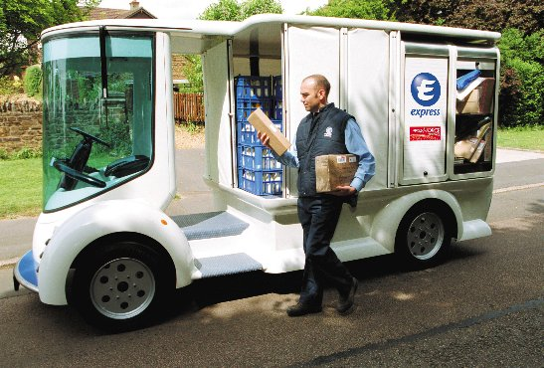
Why Would I Buy A BEV?
You should buy a BEV because it is very beneficial towards the environment. Electric power has no pollution. BEVs can have longer ranges than regular cars. BEVs are more fuel efficient and electricity costs less than gasoline. Lots of BEVs look awesome too.
I would buy a BEV because it’s fast, silent, and runs on electricity.

