Slide 1
10 Jan. 2018 SacEV General Meeting
MC: George Parrott, President, SacEV
Thanks to Nissan Technical Center for hosting this gathering!
Agenda:
6:00 p.m. Meeting opens, George
6:05 p.m. Jennifer Venema, Sac City Update
6:10 p.m. John Grindrod, SMUD 2018 Activity
6:25 p.m. Honda Clarity EV Lease Details
6:30 p.m. David Morgan, KUNI Chevy/Cad. CT-6
6:45 p.m. Sac. EV Donation vs. Dues?
6:50 p.m. Tesla Model 3 Delivery Experience
7:00 p.m. Adjourn to Garage !

Slide 2
How Far We’ve Come
1996-1999
GM EV-1

Slide 3
2011 Nissan Leaf
Chevrolet Volt

Slide 4
Level 2 and DC Chargers
There are some 48,000 charging stations in the U.S. (AC Level II and DC fast chargers), out of which almost one third are located in California – more than 15,000.
We ARE the front of the wave!

Slide 5
2018
Almost Everybody on Board
Audi, BMW, Porsche, Mercedes, VW, Mini, Cadillac, Chevrolet, Chrysler, Honda, Mitsubishi, Ford, Tesla, etc.
And prices have…DROPPED amazingly
2011 Nissan Leaf…approx. $35K for 73 miles
2018 Nissan Leaf…approx. $30K for 160 miles
2011 Volt…loaded $ 44.5 K for 42 miles EV
2018 Volt…loaded approx. $39K for 53 miles EV

Slide 6
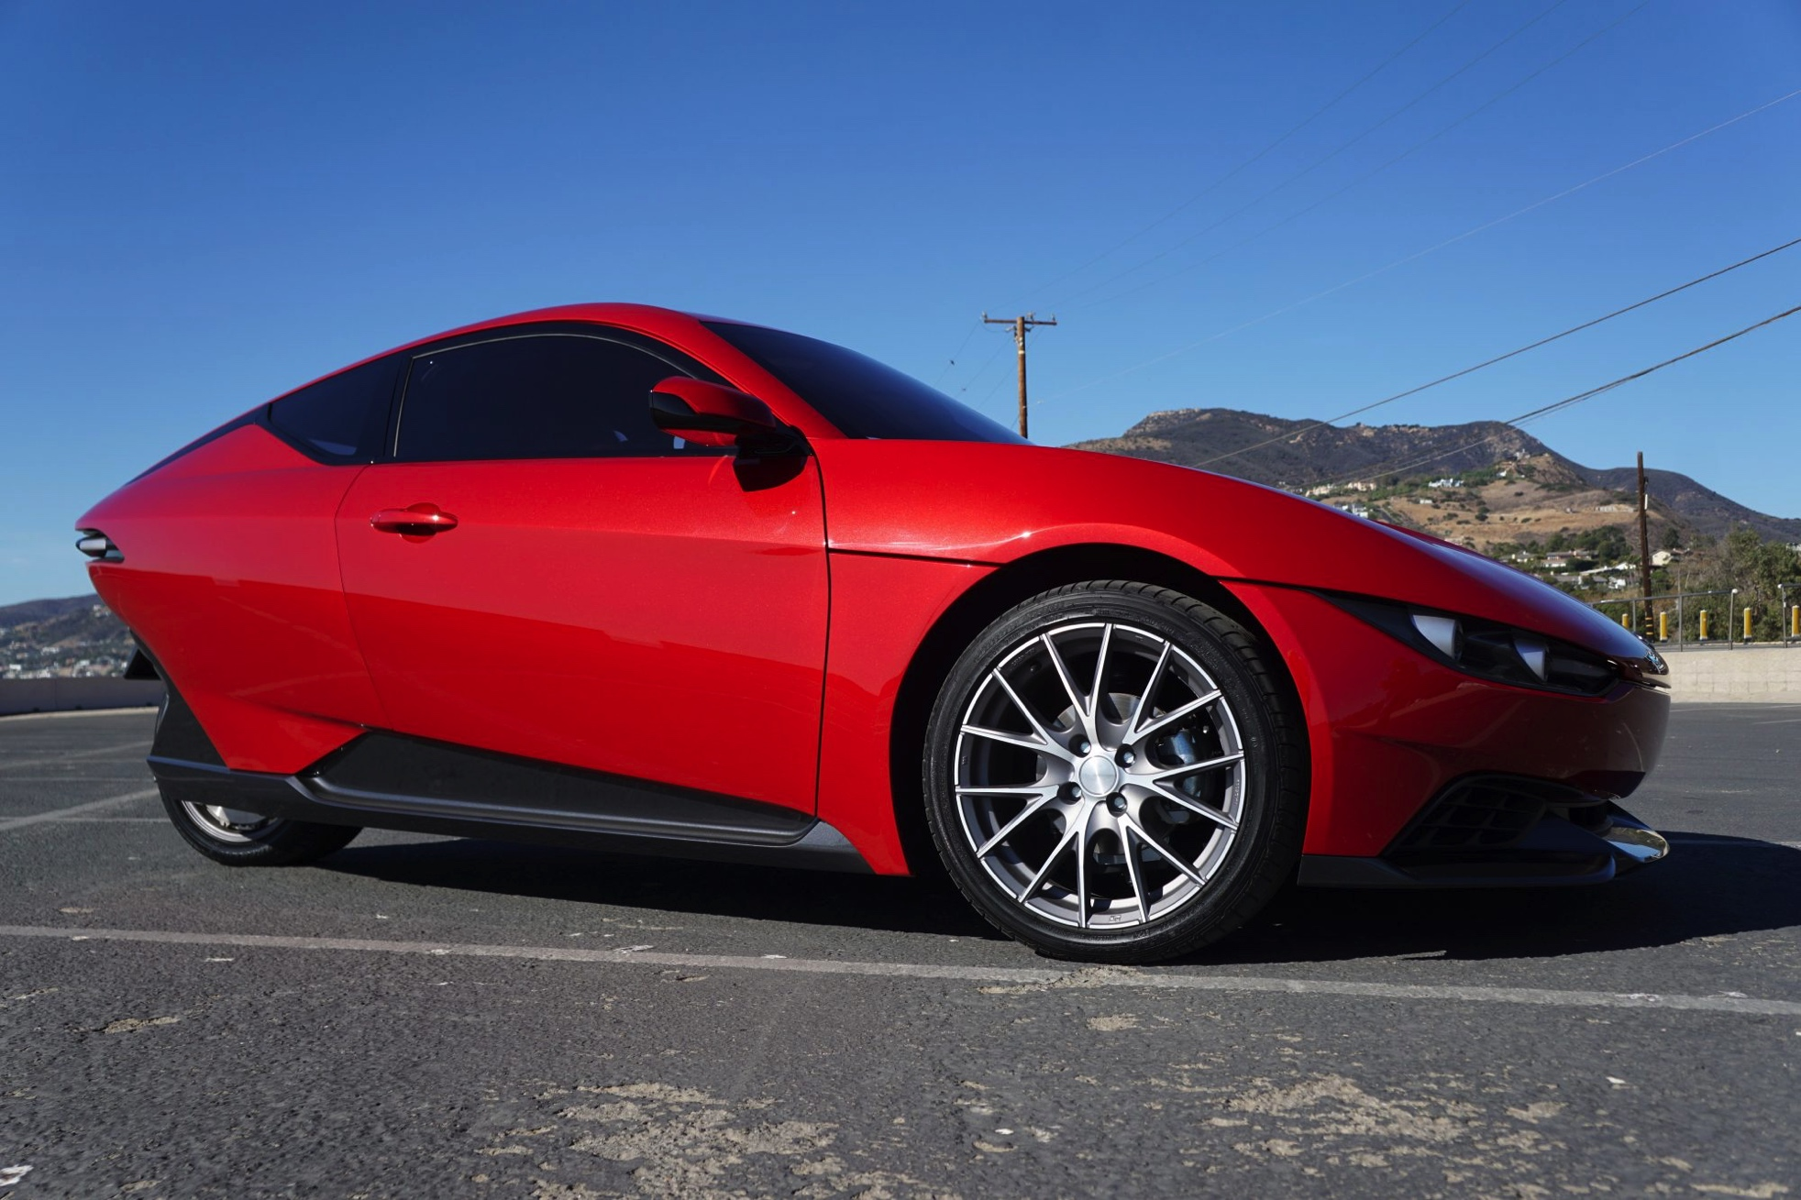
Vapor or Promise
Sonders 3 wheel, 3 passenger EV
Projected cost: $10,000
Deposits of $100 taken NOW

Slide 7
Full EV Single Car Options
Tonight’s Later FEAST:
2018 Late Arrival 225+ mile range Nissan Leaf
2018 Chevy BOLT….238 mile EPA range
2018 Tesla Model 3…220-320 mile EPA range
With cumulative INCENTIVES all under base configurations of $26,000

Slide 8
Honda Clarity EV Lease Deal 2018
89 mile range, 5 passenger,
$199
36-MONTH LEASE*
$899 DUE AT SIGNING
*plus tax and fees
2011 Leaf was $2000 down, $330/mo.

Slide 9
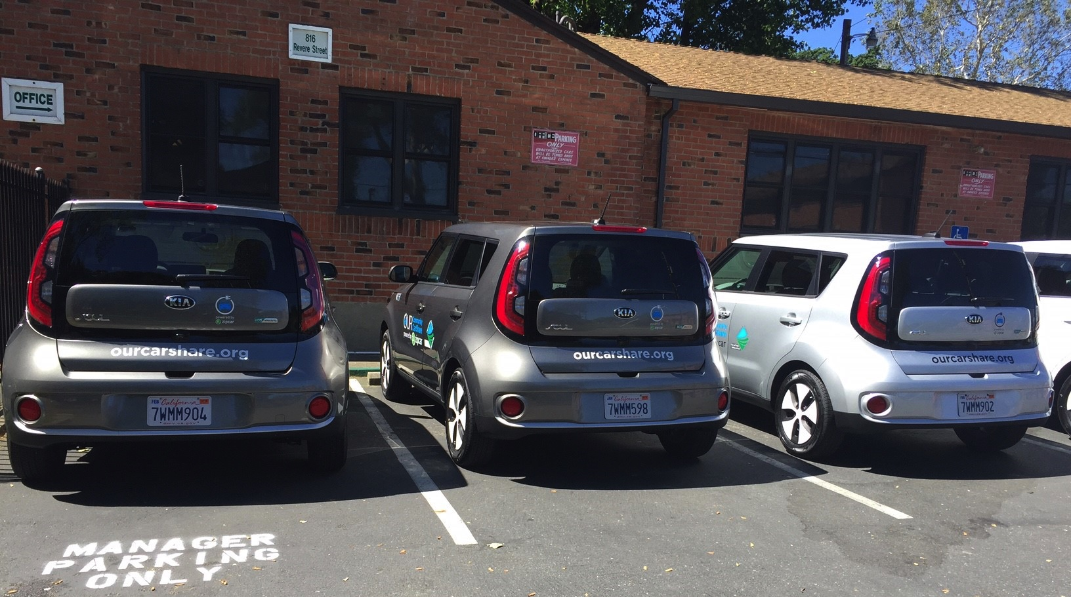
Update on City Efforts
www.cityofsacramento.org/ev
Jennifer Venema
Sustainability Manager
Department of Public Works
jvenema@cityofsacramento.org
916-808-1859

Slide 10
EV Strategy
Goals
75,000 ZEVs in Sacramento by 2025
Adopted 12/12!
Performance Targets
35% of households with ZEVs
40% of annual sales to be ZEVs
Actions

Slide 11
Framework
Action categories:
Community Charging and Infrastructure
Heavy-Duty and New ZEV Applications
Electrify America Green City Initiative
City Facility Charging Infrastructure
Fleets
Economic Development and Innovation
Programs, Partnerships, and Engagement
ZEV Access
Goals
Performance Targets
Actions
100+ actions
Notes:
Strategy we recognize – it’s more than just the infrastructure - we provide actions across 8 categories, reflecting both existing initiatives and new ones to undertake
Education, outreach – and expanding access
Leadership in the City fleet
Leveraging the significant opportunity we have with Electrify America to advance charging infrastructure and deploy new programs

Slide 12
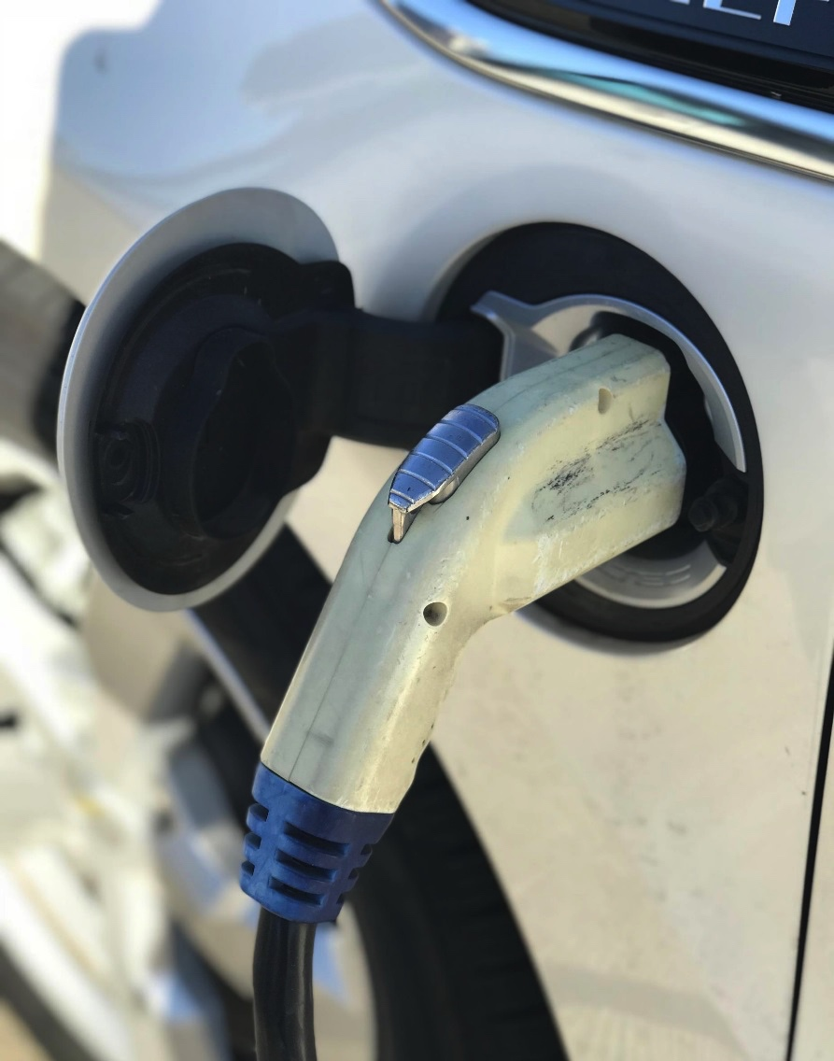
EV Parking Program
5% thresholds for free parking exceeded at all garages
November 2017 survey
168 responses
67%: program was influential for choice to drive an EV
Notes:
Most said they can charge at home
Parking discount that seems to incentivize adoption, and not just access to infrastructure

Slide 13
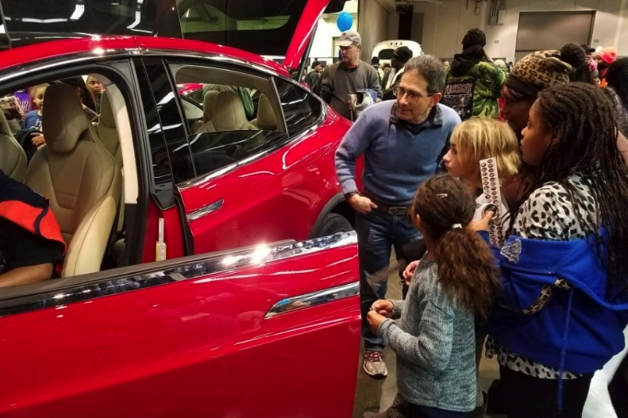
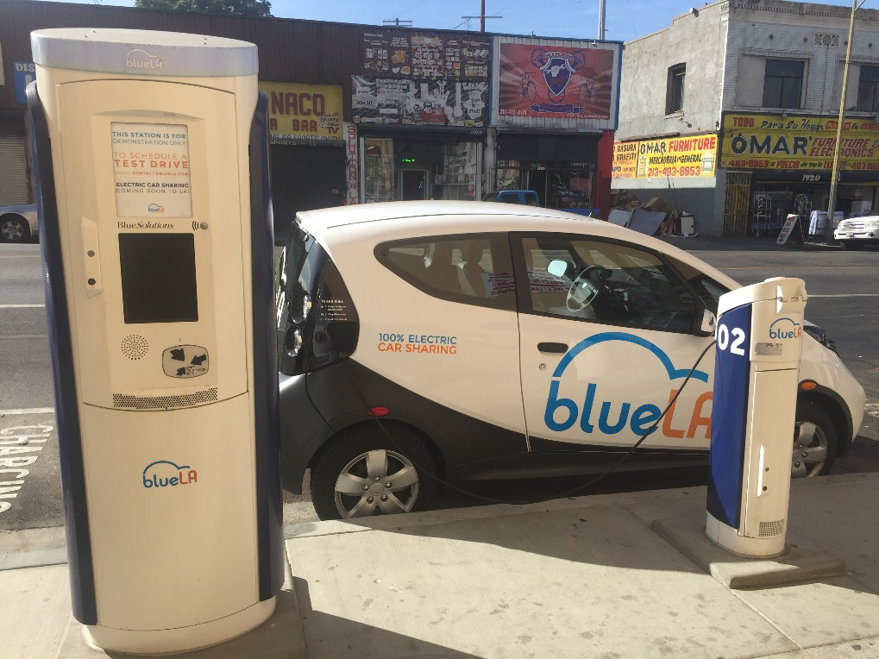
Next Steps
Implementation plan
Near-term milestones, early to mid-2018:
Car share authorizations
Curbside guidance release
EV Parking Program update

Slide 14
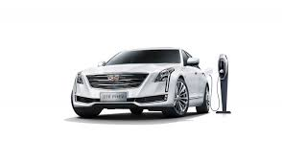
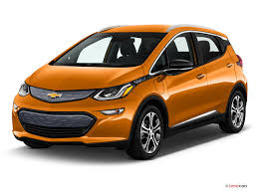

Slide 15
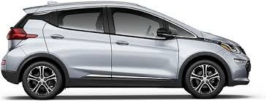
2018 Chevrolet Bolt EV
Bolt:
North American car of the year
Green Car Journal – Green Car of the Year
Green Car Reports – Best New Car to Buy
Car Connection – Best EV to Buy, Best Hatchback to Buy 2017
Car and Driver – 10Best Cars
Hispanic Motor Press – Best EV/Plug-In Vehicle
Motor Trend – Car of the Year
AutoGuide Reader’s Choice
Time Magazine’s 25 Best Inventions of 2016
Popular Science 10 Greatest Automotive Innovations Of 2016
2017 IIHS TOP SAFETY PICK

Slide 16
2018 Chevrolet Bolt
Bolt:
Vehicle Features-
238 miles electric driving
0-60 in 6.5 secs
266 LB/FT of Torque
8 color options
Regen on Demand
One pedal drive mode
10.2” Tablet like Display w/ Apple Car Play and Android Auto
4G LTE Wifi on all models
Two available models, LT and Premier

Slide 17
Test Drive the 2018 Bolt-EV

Slide 18
2018 Cadillac CT6 Plug In
CT6 Plug In :
Vehicle Features-
2.0L I-4 Turbo Direct Injection engine with 265 hp and 295 lb-ft of torque
Propulsion Battery, Lithium-Ion (18.4 kWh)
31 Miles EV Range, 335 hp total system power, 5.2 sec 0-60MPH, 62MPGe combined
Electric Variable Transmission (EVT)
Intelligent interior- Regen on Demand, Head Up Display, Wireless Phone Charging,
Teen Driver, Cadillac User Experience, Driver Awareness, Driver Assistance
Rear Seat Infotainment system, featuring dual 10” diagonal tilting HD screens
Sensor indicators- flashing/solid lights green/yellow will alert charging status
Simple Charging- vehicle is equipped with a portable 120-volt charging cord
Can charge in as little as 4.5 hours depending on charging system
LED/Concierge Lighting
Safety- Night Vision, Front Pedestrian Braking and Surround Vision

Slide 19
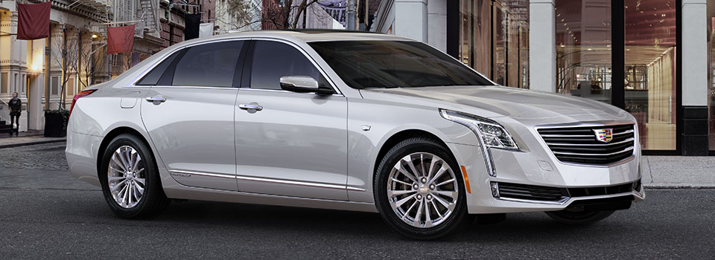
2018 Cadillac CT6 Plug In
CT6 Plug In :
Luxury Performance EV
Elegance
Strength
Style
Loaded from Factory
6 color options
3 Interior Color options

Slide 20
Overview of 2018 Cadillac CT6 PLUG IN

Slide 21
Why KUNI Chevrolet Cadillac?
#1 electric dealer in the greater Sacramento Area
#1 for Chevy lease penetration out of 19 local dealers
#1 stop shop for electric Chevrolet and Cadillac vehicles
#1 online reputation compared to Chevrolet and Cadillac dealers in our market
#1 priority- Customers Complete Satisfaction
More KUNI employees drive electric vehicles than other competitors in our market (who knows their vehicle better than the owner/driver?)
KUNI means lower than Auto Mall pricing
Dedicated to the EV consumers and the EV market

Slide 22
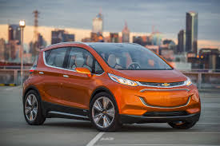
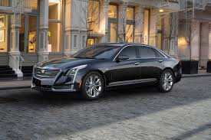
Thank you for your time
Questions and Answers

Slide 23
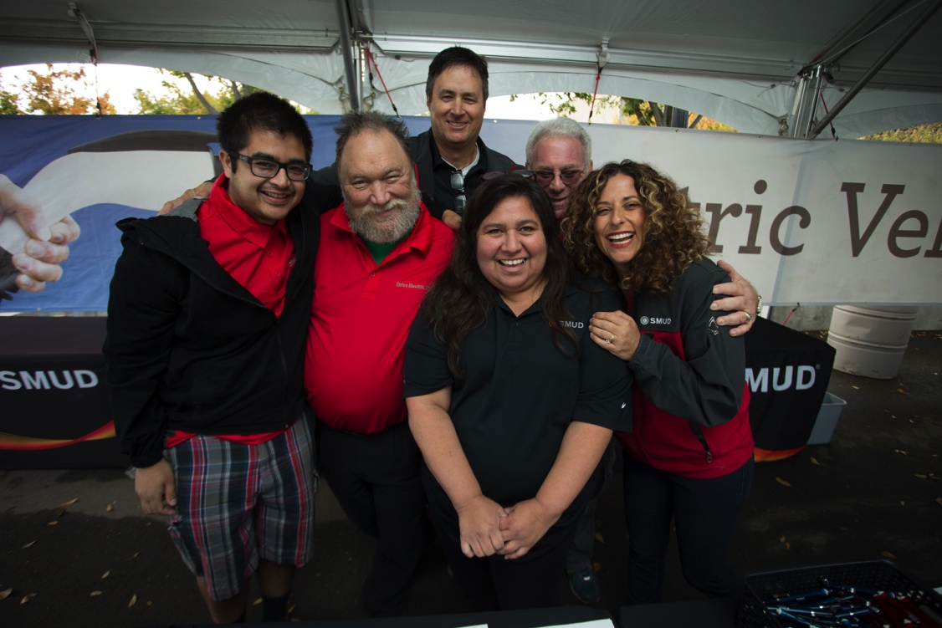
SMUD Review and Preview
2017 Events
Five Ride & Drives
Approx. 1500 unique drivers, 2300 experiences
More sales from events reported
Ten additional outreach events
Two EV seminars, two EV webinars
Thank you SacEV!!!
2017 Marketing Campaign
February to May – TV, radio, billboards, digital, buses, etc.
Substantial increase in EV awareness and incentive activity
2017 Residential EVs in SMUD Territory
Approximately 6000 EVs in SMUD territory at year end
128/month 2017 vs 93/month 2016 – 37% increase/month!
Residential EVs 90%, 10% business/govt.
2017 Incentives enhanced
From $300 to $599
Added EVSE option
About 86%/14% split cash to EVSE
1026 incentives approved! About 70% of new Res EVs

Slide 24
2017 Commercial activity
Interest in Workplace & Multifamily incentives rising – potential 290 EVSE
A few projects completed
Interest, but no uptake on DCFC incentives
2018 Events
Six Ride & Drives – 2 corporate
Many 2017 venues
Increased attention on disadvantaged
community
Looking Forward
2018 Marketing Campaign February to March – TV and other
Projecting 30% increase – 1800 new EVs, up to 7800
No change in incentive levels
Increased engagement with dealers
Workplace and Multifamily Charging easier to access
Electricians to consult on projects
Electric forklift incentives

Slide 25
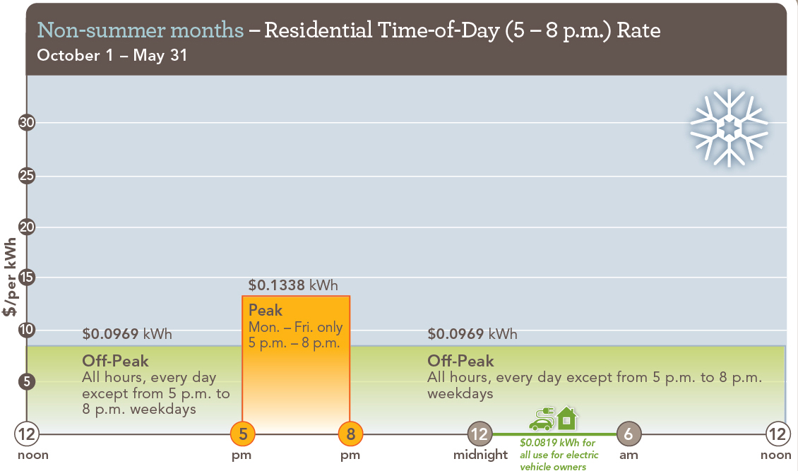
2018-2019 Residential Time-of-Day (5-8 p.m.) Rate
Notes:
To review, this chart shows you that from October 1 to May 31, Monday through Friday only, and all day on holidays, you will be at the lowest price rate.
From 5pm-8pm, demand for energy increases, and so does the price.

Slide 26
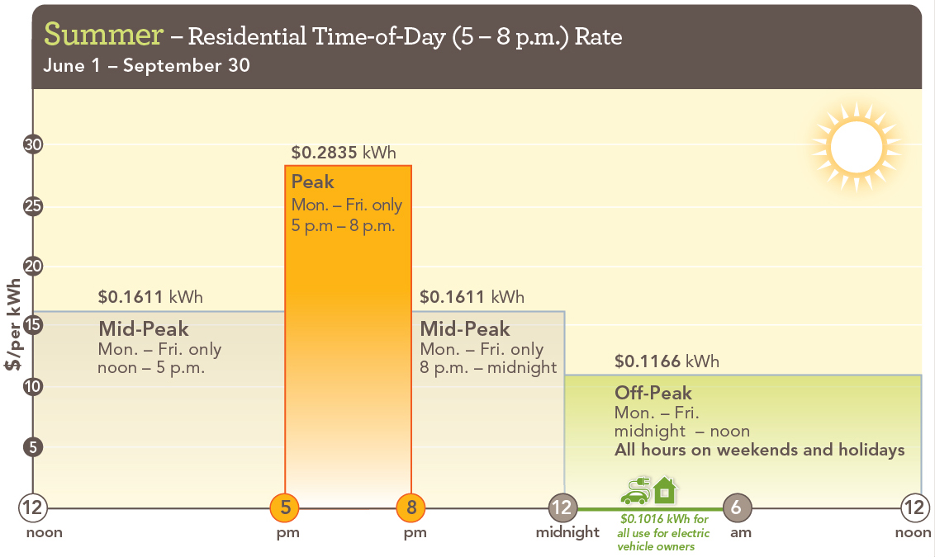
2018-2019 Residential Time-of-Day (5-8 p.m.) Rate
Notes:
This chart shows you that from June 1 to September 30, there are 3 rate periods:
Off peak: Monday-Friday plus weekends and holidays. Midnight to Noon is the lowest rate of 11.66 cents per kWh
Mid-Peak: Monday – Friday only, Noon to Midnight except 5-8 p.m. is 16.11 cents per kWh
Peak: Monday –Friday 5-8PM is 28.35 cents per kWh
From 5pm-8pm, demand for energy increases, and so does the price.

Slide 27
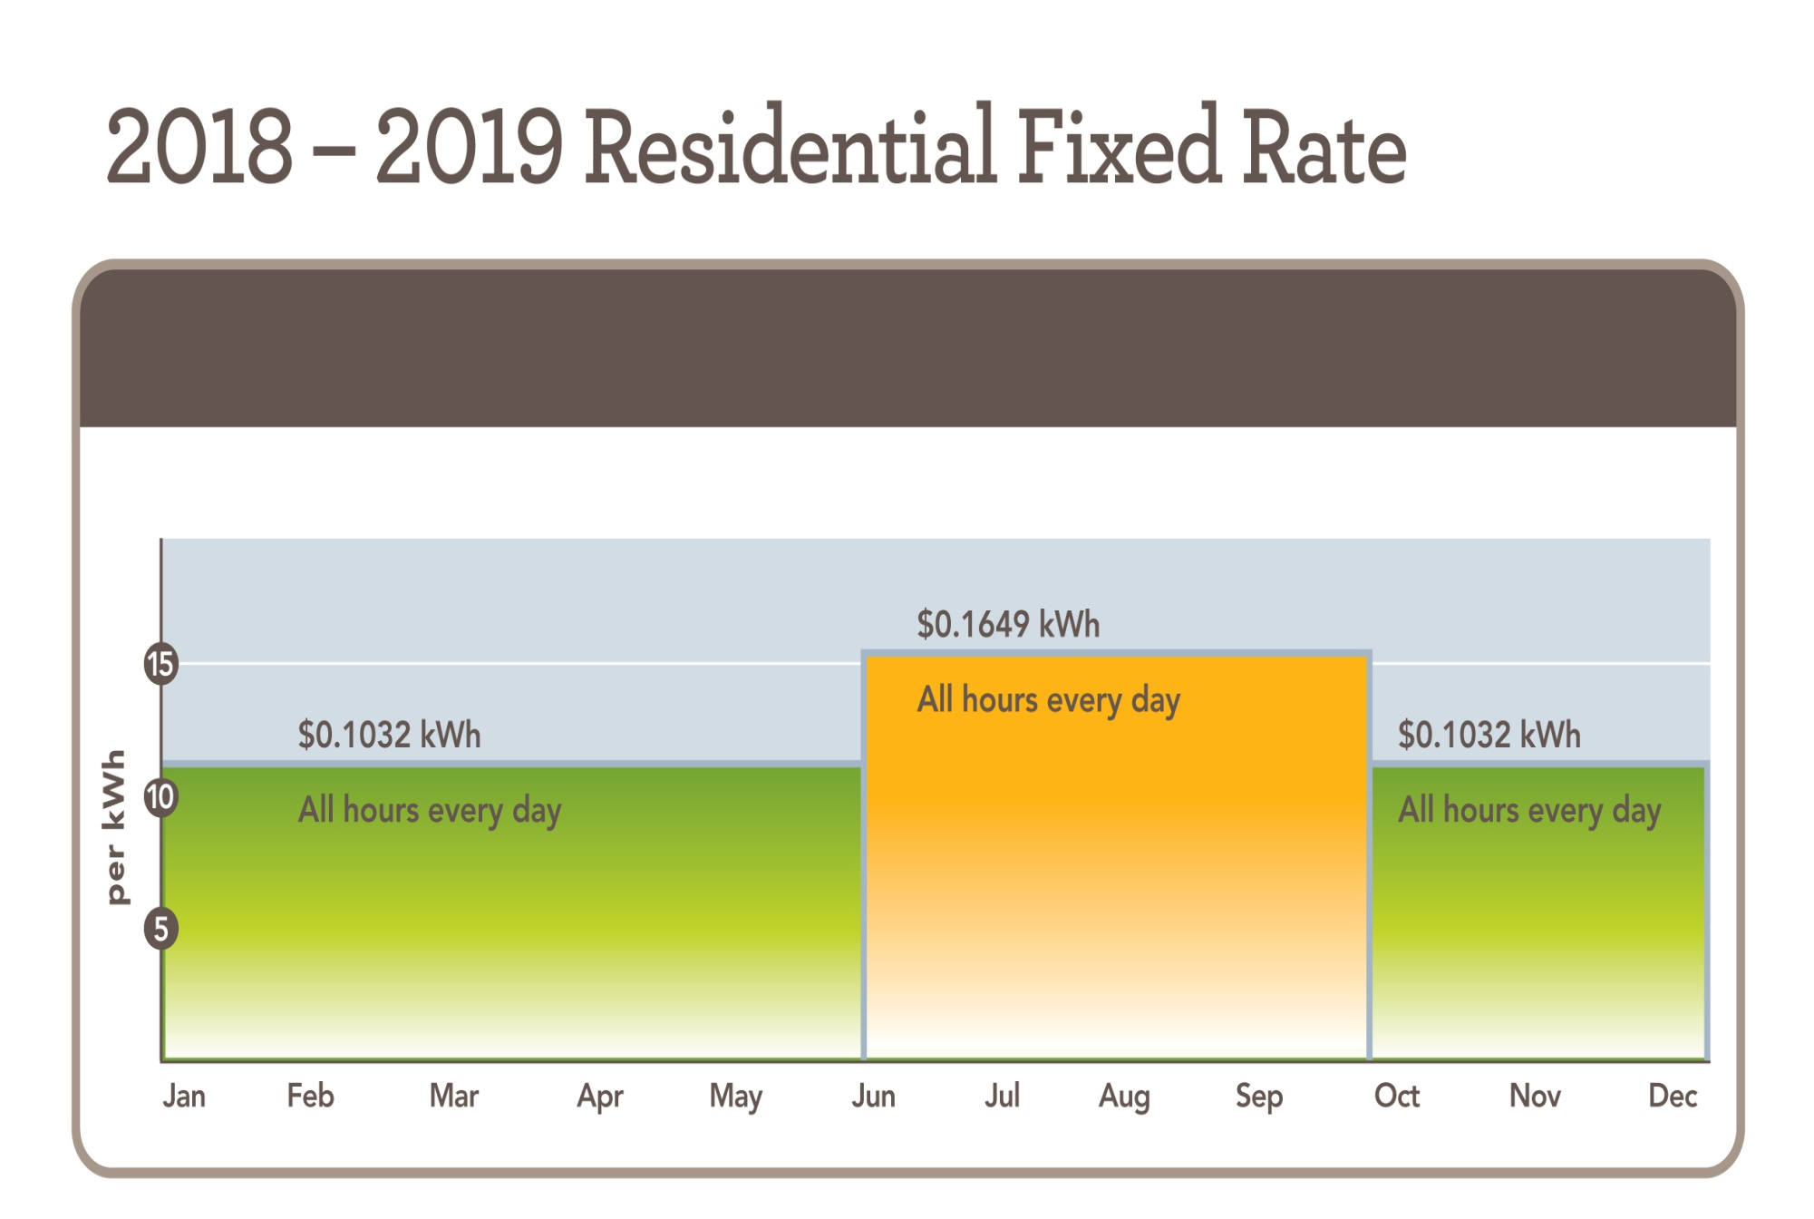
More info at SMUD.org/TOD
Notes:
The Residential Fixed rate has two rates throughout the year: 10.32 cents/kwh all hours of the day everyday in the months from January 1 to May 30, and then from October 1 to December 31.
From June 1 to September 30, the rate will be 16.49 cents/kwh all hours of the day, everyday.

